Slide 1
Processor Design
5Z032
Processor: Datapath and Control
Chapter 5
Henk Corporaal
Eindhoven University of Technology
2009

Slide 2
Topics
Building a datapath
  support a subset of the MIPS-I instruction-set
A single cycle processor datapath
  all instruction actions in one (long) cycle
A multi-cycle processor datapath
  each instructions takes multiple (shorter) cycles
Control: microprogramming
Exception support
Real stuff: Pentium Pro/II/III implementation

Slide 3
Datapath and Control
Registers &
Memories
FSM
or
Micro-
programming
Multiplexors
Buses
ALUs
Control
Datapath

Slide 4
The Processor: Datapath & Control
We're ready to look at an implementation of the MIPS
Simplified to contain only:
  memory-reference instructions: lw, sw
  arithmetic-logical instructions: add, sub, and, or, slt
  control flow instructions: beq, j
Generic Implementation:
  use the program counter (PC) to supply instruction address
  get the instruction from memory
  read registers
  use the instruction to decide exactly what to do
All instructions use the ALU after reading the registers
Why?
    memory-reference?
    arithmetic?
    control flow?

Slide 5
More Implementation Details
Abstract / Simplified View:
Two types of functional units:
  elements that operate on data values (combinational)
  elements that contain state (sequential)
D
a
t
a
R
e
g
i
s
t
e
r
#
P
C
A
d
d
r
e
s
s
I
n
s
t
r
u
c
t
i
o
n
R
e
g
i
s
t
e
r
s
A
L
U
A
d
d
r
e
s
s
I
n
s
t
r
u
c
t
i
o
n
R
e
g
i
s
t
e
r
#
m
e
m
o
r
y
D
a
t
a
R
e
g
i
s
t
e
r
#
m
e
m
o
r
y
D
a
t
a

Slide 6
State Elements
Unclocked vs. Clocked
Clocks used in synchronous logic
  when should an element that contains state be updated?
falling edge
cycle time
rising edge

Slide 7
An unclocked state element
The set-reset (SR) latch
  output depends on present inputs and also on past inputs
R
Q
Q
S
R S Q
0 0 Q
0 1 1
1 0 0
1 1 ?
Truth table:
state change

Slide 8
Latches and Flip-flops
Output is equal to the stored value inside the element
(don't need to ask for permission to look at the value)
Change of state (value) is based on the clock
  Latches: whenever the inputs change, and the clock is asserted
  Flip-flop: state changes only on a clock edge
  (edge-triggered methodology)
A clocking methodology defines when signals can be read and written
— wouldn't want to read a signal at the same time it was being written

Slide 9
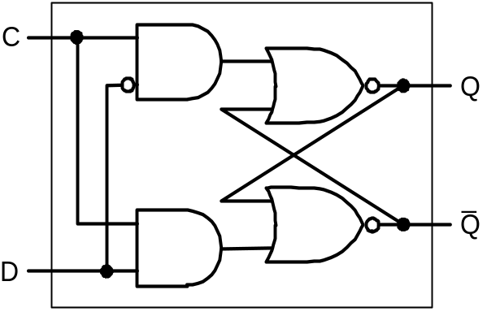
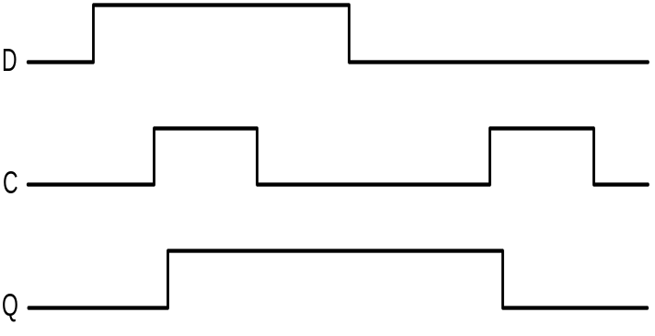
D-latch
Two inputs:
  the data value to be stored (D)
  the clock signal (C) indicating when to read & store D
Two outputs:
  the value of the internal state (Q) and it's complement

Slide 10
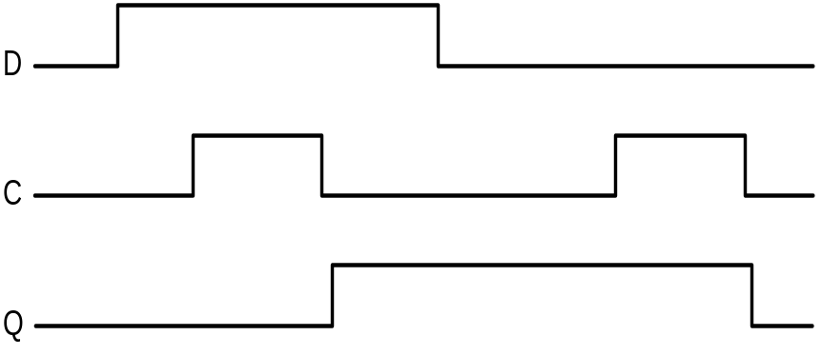
D flip-flop
Output changes only on the clock edge
D
D
D
Q
D
D
Q
Q
l
a
t
c
h
l
a
t
c
h
_
_
C
C
Q
Q
C

Slide 11
Our Implementation
An edge triggered methodology
Typical execution:
  read contents of some state elements,
  send values through some combinational logic,
  write results to one or more state elements
S
t
a
t
e
S
t
a
t
e
e
l
e
m
e
n
t
C
o
m
b
i
n
a
t
i
o
n
a
l
l
o
g
i
c
e
l
e
m
e
n
t
1
2
C
l
o
c
k
c
y
c
l
e

Slide 12
Register File
3-ported: one write, two read ports
Read reg. #1
Read
data 1
Read reg.#2
Read
data 2
Write reg.#
Write
data
Write

Slide 13
Register file: read ports
Register file built using D flip-flops
R
e
a
d
r
e
g
i
s
t
e
r
n
u
m
b
e
r
1
R
e
g
i
s
t
e
r
0
R
e
g
i
s
t
e
r
1
M
u
R
e
a
d
d
a
t
a
1
R
e
g
i
s
t
e
r
n
–
1
x
R
e
g
i
s
t
e
r
n
R
e
a
d
r
e
g
i
s
t
e
r
n
u
m
b
e
r
2
M
u
R
e
a
d
d
a
t
a
2
x
Implementation of the read ports

Slide 14
Register file: write port
Note: we still use the real clock to determine when to write
W
r
i
t
e
0
C
R
e
g
i
s
t
e
r
0
1
D
R
e
g
i
s
t
e
r
n
u
m
b
e
r
n
-
t
o
-
1
C
d
e
c
o
d
e
r
R
e
g
i
s
t
e
r
1
n
–
1
D
n
C
R
e
g
i
s
t
e
r
n
–
1
D
C
R
e
g
i
s
t
e
r
n
R
e
g
i
s
t
e
r
d
a
t
a
D

Slide 15
Simple Implementation
Include the functional units we need for each instruction
I
n
s
t
r
u
c
t
i
o
n
a
d
d
r
e
s
s
P
C
M
e
m
W
r
i
t
e
I
n
s
t
r
u
c
t
i
o
n
A
d
d
S
u
m
I
n
s
t
r
u
c
t
i
o
n
A
d
d
r
e
s
s
R
e
a
d
m
e
m
o
r
y
d
a
t
a
1
6
3
2
S
i
g
n
W
r
i
t
e
D
a
t
a
e
x
t
e
n
d
a
.
I
n
s
t
r
u
c
t
i
o
n
m
e
m
o
r
y
b
.
P
r
o
g
r
a
m
c
o
u
n
t
e
r
c
.
A
d
d
e
r
d
a
t
a
m
e
m
o
r
y
A
L
U
c
o
n
t
r
o
l
M
e
m
R
e
a
d
5
R
e
a
d
3
r
e
g
i
s
t
e
r
1
R
e
a
d
a
.
D
a
t
a
m
e
m
o
r
y
u
n
i
t
b
.
S
i
g
n
-
e
x
t
e
n
s
i
o
n
u
n
i
t
R
e
g
i
s
t
e
r
5
R
e
a
d
d
a
t
a
1
n
u
m
b
e
r
s
r
e
g
i
s
t
e
r
2
Z
e
r
o
5
W
r
i
t
e
R
e
g
i
s
t
e
r
s
D
a
t
a
A
L
U
A
L
U
r
e
g
i
s
t
e
r
r
e
s
u
l
t
d
R
e
a
d
D
a
t
a
W
r
i
t
e
a
t
a
2
d
a
t
a
R
e
g
W
r
i
t
e
a
.
R
e
g
i
s
t
e
r
s
b
.
A
L
U
Why do we need this stuff?

Slide 16
Building the Datapath
Use multiplexors to stitch them together
P
C
S
r
c
A
d
d
M
u
x
4
A
d
d
r
e
A
L
U
s
u
l
t
S
h
i
f
t
l
e
f
t
2
R
e
g
i
s
t
e
r
s
A
L
U
o
p
e
r
a
t
i
o
n
R
e
a
d
A
L
U
S
r
c
3
M
e
m
W
r
i
t
e
P
C
R
e
a
d
r
e
g
i
s
t
e
r
1
R
e
a
d
a
d
d
r
e
s
s
R
e
a
d
d
a
t
a
1
M
e
m
t
o
R
e
g
r
e
g
i
s
t
e
r
2
Z
e
r
o
I
n
s
t
r
u
c
t
i
o
n
W
r
i
t
e
R
e
a
d
A
L
U
A
L
U
R
e
a
d
r
e
g
i
s
t
e
r
d
a
t
a
2
M
r
e
s
u
l
t
A
d
d
r
e
s
s
d
a
t
a
I
n
s
t
r
u
c
t
i
o
n
u
M
m
e
m
o
r
y
W
r
i
t
e
x
D
a
t
a
u
d
a
t
a
x
W
r
i
t
e
m
e
m
o
r
y
R
e
g
W
r
i
t
e
d
a
t
a
1
6
S
i
g
n
3
2
e
x
t
e
n
d
M
e
m
R
e
a
d

Slide 17
Our Simple Control Structure
All of the logic is combinational
We wait for everything to settle down, and the right thing to be done
  ALU might not produce “right answer” right away
  we use write signals along with clock to determine when to write
Cycle time determined by length of the longest path
S
t
a
t
e
S
t
a
t
e
e
l
e
m
e
n
t
C
o
m
b
i
n
a
t
i
o
n
a
l
l
o
g
i
c
e
l
e
m
e
n
t
1
2
C
l
o
c
k
c
y
c
l
e
We are ignoring some details like setup and hold times !

Slide 18
Control
Selecting the operations to perform (ALU, read/write, etc.)
Controlling the flow of data (multiplexor inputs)
Information comes from the 32 bits of the instruction
Example:
add $8, $17, $18 Instruction Format:
000000 10001 10010 01000 00000 100000
op rs rt rd shamt funct
ALU's operation based on instruction type and function code

Slide 19
Control: 2 level implementation
bit
31
6
Opcode
Control 2
26
2
ALUop
00: lw, sw
01: beq
10: add, sub, and, or, slt
instruction register
3
Control 1
ALUcontrol
000: and
001: or
010: add
110: sub
111: set on less than
5
6
ALU
Funct.
0

Slide 20
Datapath with Control
0
M
u
x
A
d
d
r
e
A
L
U
1
s
u
l
t
A
d
d
S
h
i
f
t
R
e
g
D
s
t
l
e
f
t
2
4
B
r
a
n
c
h
M
e
m
R
e
a
d
M
e
m
I
n
s
t
r
u
c
t
i
o
n
[
3
1
–
2
6
]
C
o
n
t
r
o
l
t
o
R
e
g
A
L
U
O
p
M
e
m
W
r
i
t
e
A
L
U
S
r
c
R
e
g
W
r
i
t
e
R
e
a
d
I
n
s
t
r
u
c
t
i
o
n
[
2
5
–
2
1
]
R
e
a
d
P
C
a
d
d
r
e
s
s
r
e
g
i
s
t
e
r
1
R
e
a
d
I
n
s
t
r
u
c
t
i
o
n
[
2
0
–
1
6
]
R
e
a
d
d
a
t
a
1
I
n
s
t
r
u
c
t
i
r
e
g
i
s
t
e
r
2
Z
e
r
o
[
3
1
–
o
n
0
R
e
g
i
s
t
e
r
s
R
e
a
d
A
L
U
A
L
U
0
]
M
W
r
i
t
e
d
a
t
a
2
0
r
e
s
u
l
t
A
d
d
r
e
s
s
R
e
a
d
1
I
n
s
t
r
u
c
t
i
o
n
u
r
e
g
i
s
t
e
r
M
d
a
t
a
M
m
e
m
o
r
y
I
n
s
t
r
u
c
t
i
o
n
[
1
5
–
1
1
]
x
W
r
i
t
e
u
u
1
d
a
t
a
x
D
a
t
a
x
1
m
e
m
o
r
y
0
W
d
r
i
t
e
a
t
a
I
n
s
t
r
u
c
t
i
o
n
[
1
5
–
0
]
1
6
S
i
g
n
3
2
e
x
t
e
n
d
A
L
U
c
o
n
t
r
o
l
Fig. 5.19
I
n
s
t
r
u
c
t
i
o
n
[
5
–
0
]

Slide 21
ALU Control1
What should the ALU do with this instruction
example: lw $1, 100($2)
35 2 1 100
op rs rt 16 bit offset
ALU control input
000 AND
001 OR
010 add
110 subtract
111 set-on-less-than
Why is the code for subtract 110 and not 011?

Slide 22
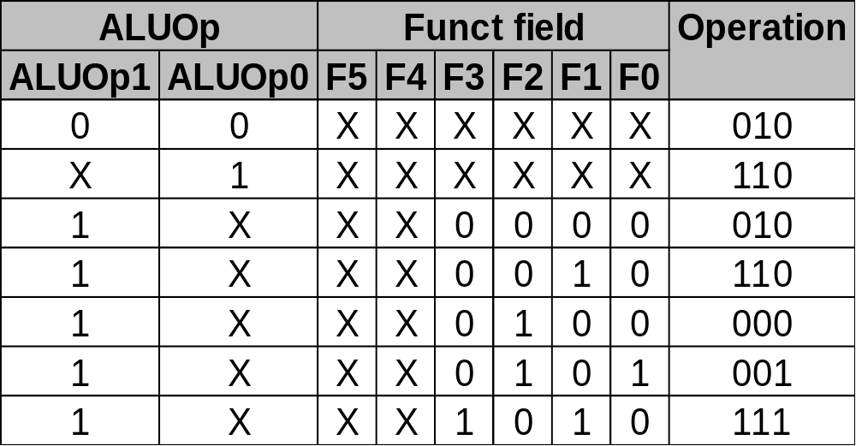
ALU Control1
Must describe hardware to compute 3-bit ALU control input
  given instruction type
  00 = lw, sw
  01 = beq,
  10 = arithmetic
  function code for arithmetic
Describe it using a truth table (can turn into gates):
ALU Operation class,
computed from instruction type

Slide 23
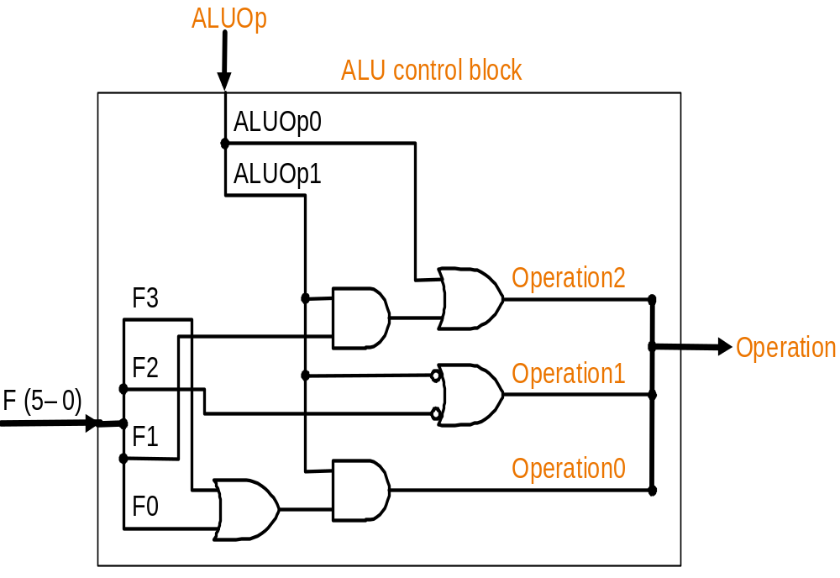
ALU Control1
Simple combinational logic (truth tables)

Slide 24
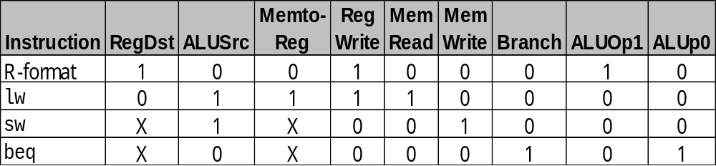
Deriving Control2 signals
Input
9 control (output) signals
Determine these control signals directly from the opcodes:
R-format: 0
lw: 35
sw: 43
beq: 4

Slide 25
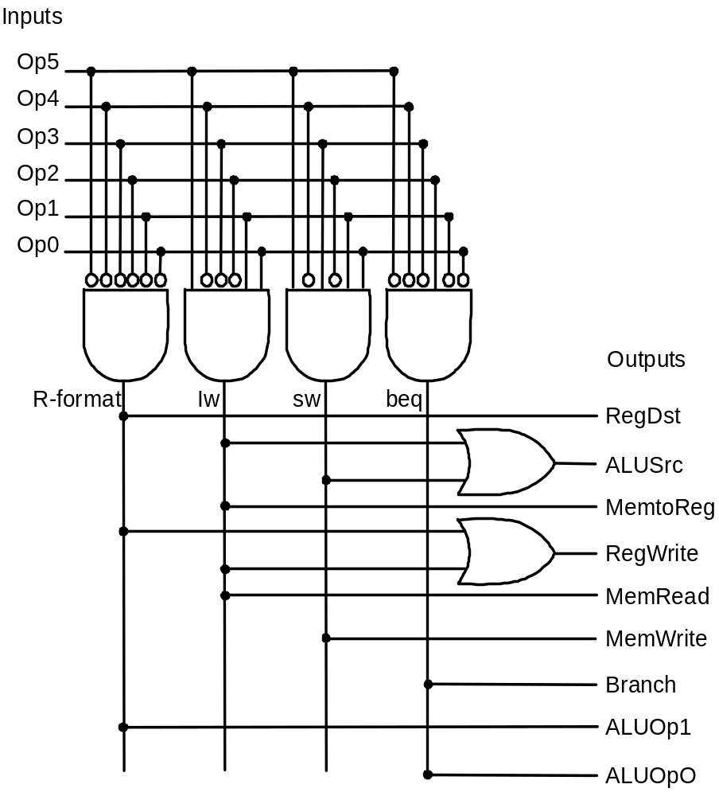
Control 2
PLA example implementation

Slide 26
Single Cycle Implementation
Calculate cycle time assuming negligible delays except:
  memory (2ns), ALU and adders (2ns), register file access (1ns)
P
C
S
r
c
1
A
d
d
M
u
A
L
U
x
4
A
d
d
r
e
s
u
l
t
0
R
e
g
W
r
i
t
e
S
h
i
f
t
l
e
f
t
2
I
n
s
t
r
u
c
t
i
o
n
[
2
5
–
2
1
]
R
e
a
d
P
C
R
e
a
d
r
e
g
i
s
t
e
r
1
R
e
a
d
M
e
m
W
r
i
t
e
a
d
d
r
e
s
s
I
n
s
t
r
u
c
t
i
o
n
[
2
0
–
1
6
]
R
e
a
d
d
a
t
a
1
A
L
U
S
r
c
M
e
m
t
o
R
e
g
I
n
s
t
r
u
c
t
i
o
n
r
e
g
i
s
t
e
r
2
R
e
a
d
Z
e
r
o
[
3
1
–
0
]
1
W
r
i
t
e
d
a
t
a
2
1
A
L
U
A
L
U
R
e
a
d
M
r
e
g
i
s
t
e
r
M
r
e
s
u
l
t
A
d
d
r
e
s
s
d
a
t
a
1
I
n
s
t
r
u
c
t
i
o
n
I
n
s
t
r
u
c
t
i
o
n
[
1
5
–
1
1
]
u
u
M
m
e
m
o
r
y
x
W
r
i
t
e
R
e
g
i
s
t
e
r
s
x
u
0
d
a
t
a
0
x
W
r
i
t
e
D
a
t
a
0
R
e
g
D
s
t
1
6
d
a
t
a
m
e
m
o
r
y
I
n
s
t
r
u
c
t
i
o
n
[
1
5
–
0
]
S
i
g
n
3
2
e
x
t
e
n
d
A
L
U
M
e
m
R
e
a
d
c
o
n
t
r
o
l
I
n
s
t
r
u
c
t
i
o
n
[
5
–
0
]
A
L
U
O
p

Slide 27
Single Cycle Implementation
Memory (2ns), ALU & adders (2ns), reg. file access (1ns)
Fixed length clock: longest instruction is the ‘lw’ which requires 8 ns
Variable clock length (not realistic, just as exercise):
  R-instr: 6 ns
  Load: 8 ns
  Store: 7 ns
  Branch: 5 ns
  Jump: 2 ns
Average depends on instruction mix (see pg 374)

Slide 28
Where we are headed
Single Cycle Problems:
  what if we had a more complicated instruction like floating point?
  wasteful of area: NO Sharing of Hardware resources
One Solution:
  use a “smaller” cycle time
  have different instructions take different numbers of cycles
  a “multicycle” datapath:
I
n
s
t
r
u
c
t
i
o
n
r
e
g
i
s
t
e
r
D
a
t
a
P
C
A
d
d
r
e
s
s
IR
A
I
n
s
t
r
u
c
t
i
o
n
R
e
g
i
s
t
e
r
#
M
e
m
o
r
y
o
r
d
a
t
a
R
e
g
i
s
t
e
r
s
A
L
U
A
L
U
O
u
t
M
e
m
o
r
y
R
e
g
i
s
t
e
r
#
D
a
t
a
d
a
t
a
B
r
e
g
i
s
t
e
r
R
e
g
i
s
t
e
r
#
MDR

Slide 29
Multicycle Approach
We will be reusing functional units
  ALU used to compute address and to increment PC
  Memory used for instruction and data
Add registers after every major functional unit
Our control signals will not be determined solely by instruction
  e.g., what should the ALU do for a “subtract” instruction?
We’ll use a finite state machine (FSM) or microcode for control

Slide 30
Review: finite state machines
Finite state machines:
  a set of states and
  next state function (determined by current state and the input)
  output function (determined by current state and possibly input)
  We’ll use a Moore machine (output based only on current state)
N
e
x
t
s
t
a
t
e
C
u
r
r
e
n
N
e
x
t
-
s
t
a
t
e
t
s
t
a
t
e
f
u
n
c
t
i
o
n
C
l
o
c
k
I
n
p
u
t
s
O
u
t
p
u
t
O
u
t
p
u
t
s
f
u
n
c
t
i
o
n

Slide 31
Review: finite state machines
Example:
B. 21 A friend would like you to build an “electronic eye” for use as a fake security device. The device consists of three lights lined up in a row, controlled by the outputs Left, Middle, and Right, which, if asserted, indicate that a light should be on. Only one light is on at a time, and the light “moves” from left to right and then from right to left, thus scaring away thieves who believe that the device is monitoring their activity. Draw the graphical representation for the finite state machine used to specify the electronic eye. Note that the rate of the eye’s movement will be controlled by the clock speed (which should not be too great) and that there are essentially no inputs.

Slide 32
Multicycle Approach
Break up the instructions into steps, each step takes a cycle
  balance the amount of work to be done
  restrict each cycle to use only one major functional unit
At the end of a cycle
  store values for use in later cycles (easiest thing to do)
  introduce additional “internal” registers
Notice: we distinguish
  processor state: programmer visible registers
  internal state: programmer invisible registers (like IR, MDR, A, B, and ALUout)

Slide 33
Multicycle Approach
P
C
0
0
M
I
n
s
t
r
u
c
t
i
o
n
R
e
a
d
M
u
A
d
d
r
e
s
s
[
2
5
–
2
1
]
r
e
g
i
s
t
e
r
1
u
x
I
n
s
t
r
u
c
t
i
o
n
R
e
a
d
R
e
a
d
A
x
1
M
e
m
o
r
y
[
2
0
–
1
6
]
r
e
g
i
s
t
e
r
2
d
a
t
a
1
1
Z
e
r
o
M
e
m
D
a
t
a
0
R
e
g
i
s
t
e
r
s
A
L
U
A
L
U
A
L
U
O
u
t
r
e
s
u
I
n
s
t
r
u
c
t
i
o
n
W
l
t
M
r
i
t
e
R
e
a
d
[
1
5
–
0
]
I
n
s
t
r
u
c
t
i
o
n
u
r
e
g
i
s
t
e
r
d
a
t
a
2
B
0
W
r
i
t
e
I
n
s
t
r
u
c
t
i
o
n
[
1
5
–
1
1
]
x
W
4
1
M
d
a
t
a
r
e
g
i
s
t
e
r
1
r
i
t
e
u
d
a
t
a
2
x
I
n
s
t
r
u
c
t
i
o
n
0
3
[
1
5
–
0
]
M
u
x
M
e
m
o
r
y
1
d
a
t
a
1
6
S
3
2
S
h
i
f
t
r
e
g
i
s
t
e
r
i
g
n
e
x
t
e
n
d
l
e
f
t
2

Slide 34
Multicycle Approach
Note that previous picture does not include:
  branch support
  jump support
  Control lines and logic
For complete picture see fig 5.33 page 383
Tclock > max (ALU delay, Memory access, Regfile access)

Slide 35
Five Execution Steps
Instruction Fetch
Instruction Decode and Register Fetch
Execution, Memory Address Computation, or Branch Completion
Memory Access or R-type instruction completion
Write-back step
INSTRUCTIONS TAKE FROM 3 - 5 CYCLES!

Slide 36
Step 1: Instruction Fetch
Use PC to get instruction and put it in the Instruction Register
Increment the PC by 4 and put the result back in the PC
Can be described succinctly using RTL "Register-Transfer Language"
IR = Memory[PC];
PC = PC + 4;
Can we figure out the values of the control signals?
What is the advantage of updating the PC now?

Slide 37
Step 2: Instruction Decode and Register Fetch
Read registers rs and rt in case we need them
Compute the branch address in case the instruction is a branch
Previous two actions are done optimistically!!
RTL:
A = Reg[IR[25-21]];
B = Reg[IR[20-16]];
ALUOut = PC+(sign-extend(IR[15-0])<< 2);
We aren't setting any control lines based on the instruction type
(we are busy "decoding" it in our control logic)

Slide 38
Step 3 (instruction dependent)
ALU is performing one of four functions, based on instruction type
Memory Reference:
ALUOut = A + sign-extend(IR[15-0]);
R-type:
ALUOut = A op B;
Branch:
if (A==B) PC = ALUOut;
Jump:
PC = PC[31-28] || (IR[25-0]<<2)

Slide 39
Step 4 (R-type or memory-access)
Loads and stores access memory
MDR = Memory[ALUOut];
or
Memory[ALUOut] = B;
R-type instructions finish
Reg[IR[15-11]] = ALUOut;
The write actually takes place at the end of the cycle on the edge

Slide 40
Write-back step
Memory read completion step
Reg[IR[20-16]]= MDR;
What about all the other instructions?

Slide 41
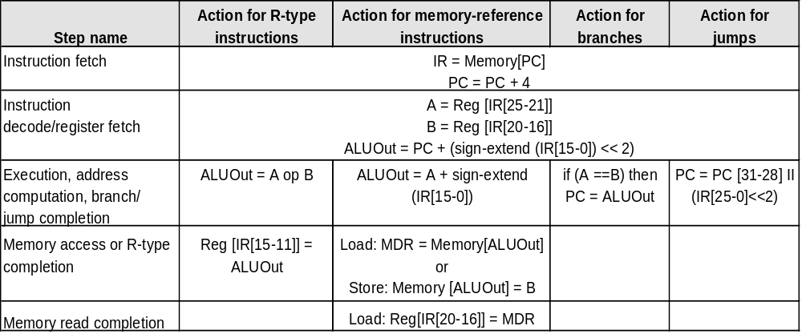
Summary execution steps
Steps taken to execute any instruction class

Slide 42
Simple Questions
How many cycles will it take to execute this code?
lw $t2, 0($t3)
lw $t3, 4($t3)
beq $t2, $t3, L1 #assume not taken
add $t5, $t2, $t3
sw $t5, 8($t3)
L1: ...
What is going on during the 8th cycle of execution?
In what cycle does the actual addition of $t2 and $t3 takes place?

Slide 43
Implementing the Control
Value of control signals is dependent upon:
  what instruction is being executed
  which step is being performed
Use the information we have accumulated to specify a finite state machine (FSM)
  specify the finite state machine graphically, or
  use microprogramming
Implementation can be derived from specification

Slide 44
FSM: high level view
Start/reset
Instruction fetch, decode and register fetch
Memory access
instructions
R-type
instructions
Branch
instruction
Jump
instruction

Slide 45
Graphical Specification of FSM
I
n
s
t
r
u
c
t
i
o
n
d
e
c
o
d
e
/
0
I
n
s
t
r
u
c
t
i
o
n
f
e
t
c
h
r
e
g
i
s
t
e
r
f
e
t
c
h
M
e
m
R
e
a
d
1
A
L
U
S
r
c
A
=
0
I
o
r
D
=
0
A
L
U
S
r
c
A
=
0
How many state bits will we need?
S
t
a
r
t
I
R
W
r
i
t
e
A
L
U
S
r
c
B
=
1
1
A
L
U
S
r
c
B
=
0
1
A
L
U
O
p
=
0
0
A
L
U
O
p
=
0
0
P
C
W
r
i
t
e
P
C
S
o
u
r
c
e
=
0
0
e
)
'
)
y
p
Q
)
-
t
E
'
R
B
J
p
=
'
'
'
)
(
O
p
=
=
M
e
m
o
r
y
a
d
d
r
e
s
s
'
S
W
B
r
a
n
c
h
O
p
p
=
(
O
J
u
m
p
c
o
m
p
u
t
a
t
i
o
n
W
'
)
o
r
(
O
E
x
e
c
u
t
i
o
n
c
o
m
p
l
e
t
i
o
n
(
c
o
m
p
l
e
t
i
o
n
2
(
O
p
=
'
L
6
8
9
A
L
U
S
r
c
A
=
1
A
L
U
S
r
c
A
=
1
A
L
U
S
r
c
B
=
1
0
A
L
U
S
r
c
A
=
1
A
L
U
S
r
c
B
=
0
0
P
C
W
r
i
t
e
A
L
U
O
p
=
0
0
A
L
U
S
r
c
B
=
0
0
A
L
U
O
p
=
0
1
P
C
S
o
u
r
c
e
=
1
0
A
L
U
O
p
=
1
0
P
C
W
r
i
t
e
C
o
n
d
P
C
S
o
u
r
c
e
=
0
1
)
(
O
p
'
=
W
'
L
S
'
W
=
'
)
p
M
e
m
o
r
y
M
e
m
o
r
y
O
(
a
c
c
e
s
s
a
c
c
e
s
s
R
-
t
y
p
e
c
o
m
p
l
e
t
i
o
n
3
5
7
M
e
m
R
e
a
d
M
e
m
W
r
i
t
e
R
e
g
D
s
t
=
1
I
o
r
D
=
1
I
o
r
D
=
1
R
e
g
W
r
i
t
e
M
e
m
t
o
R
e
g
=
0
4
W
r
i
t
e
-
b
a
c
k
s
t
e
p
R
e
g
D
s
t
=
0
R
e
g
W
r
i
t
e
M
e
m
t
o
R
e
g
=
1

Slide 46
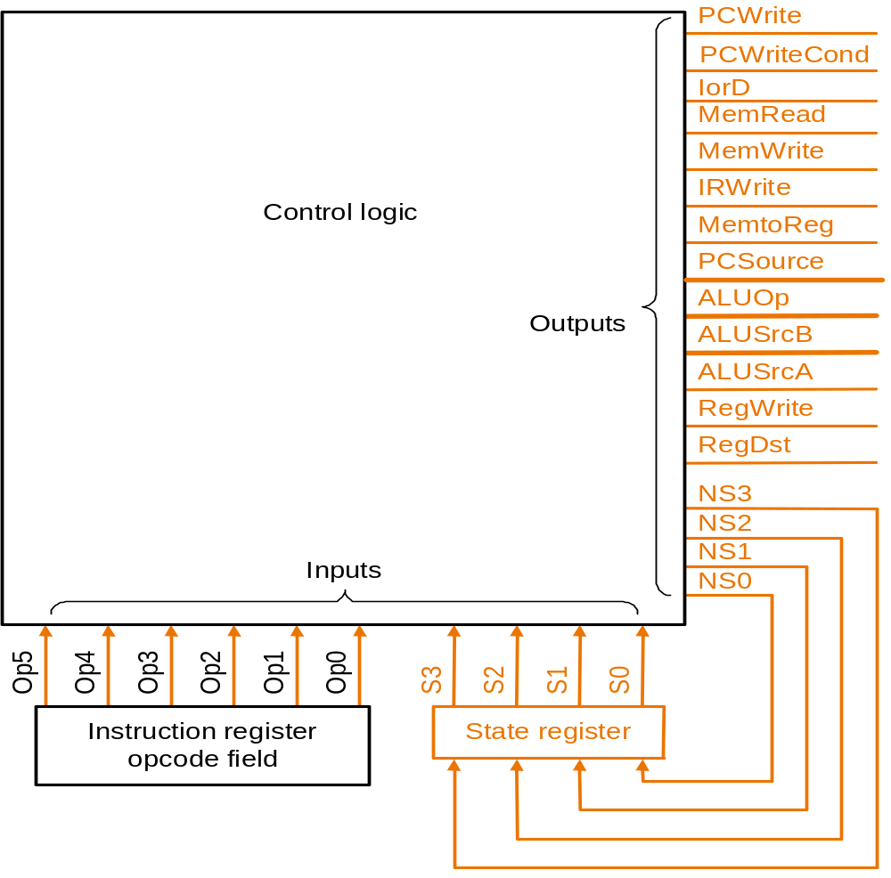
Finite State Machine for Control
Implementation:

Slide 47
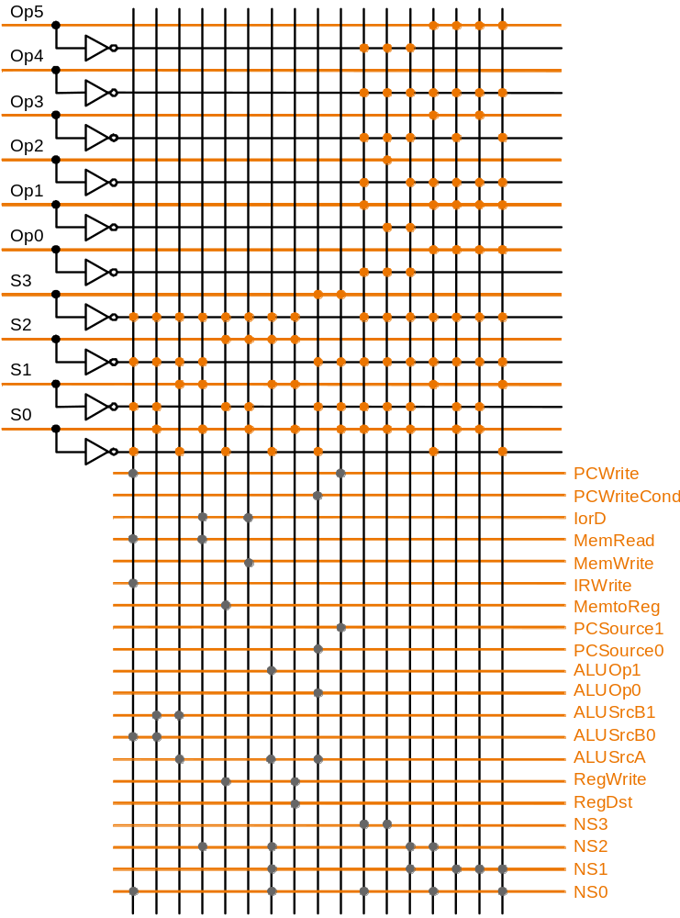
PLA Implemen-tation
opcode
(see fig C.14)
current
state
If I picked a horizontal or vertical line could you explain it ?
What type of FSM is used?
datapath control
next
state

Slide 48
ROM Implementation
ROM = "Read Only Memory"
  values of memory locations are fixed ahead of time
A ROM can be used to implement a truth table
  if the address is m-bits, we can address 2^{m} entries in the ROM
  our outputs are the bits of data that the address points to
address
data
ROM
0 0 0 0 0 1 1
0 0 1 1 1 0 0
0 1 0 1 1 0 0
0 1 1 1 0 0 0
1 0 0 0 0 0 0
1 0 1 0 0 0 1
1 1 0 0 1 1 0
1 1 1 0 1 1 1
n
bits
m
bits
m is the "heigth", and n is the "width"

Slide 49
ROM Implementation
How many inputs are there?
6 bits for opcode, 4 bits for state = 10 address lines
(i.e., 2¹⁰ = 1024 different addresses)
How many outputs are there?
16 datapath-control outputs, 4 state bits = 20 outputs
ROM is 2¹⁰ x 20 = 20K bits
(very large and a rather unusual size)
Rather wasteful, since for lots of the entries, the outputs are the same
— i.e., opcode is often ignored

Slide 50
ROM Implementation
Cheaper implementation:
Exploit the fact that the FSM is a Moore machine ==>
  Control outputs only depend on current state and not on other incoming control signals !
  Next state depends on all inputs
Break up the table into two parts
— 4 state bits tell you the 16 outputs, 2⁴ x 16 bits of ROM
— 10 bits tell you the 4 next state bits, 2¹⁰ x 4 bits of ROM
— Total number of bits: 4.3K bits of ROM

Slide 51
ROM vs PLA
PLA is much smaller
  can share product terms (ROM has an entry (=address) for every product term
  only need entries that produce an active output
  can take into account don't cares
Size of PLA:
(#inputs × #product-terms) + (#outputs × #product-terms)
  For this example: (10x17)+(20x17) = 460 PLA cells
PLA cells usually slightly bigger than the size of a ROM cell

Slide 52
Another Implementation Style
Real machines have many instructions => complex FSM with many states
  Graphical specification becomes cumbersome
Specify control as an instruction
  microinstructions
  built out of separate fields (for controlling ALU, SRC1, SCR2, etc)
Exploit the fact that usually the next state is the next microinstruction (just like in a sequential programming language)
  default sequencing
  use micro program counter (indicating next state = next instr.)

Slide 53
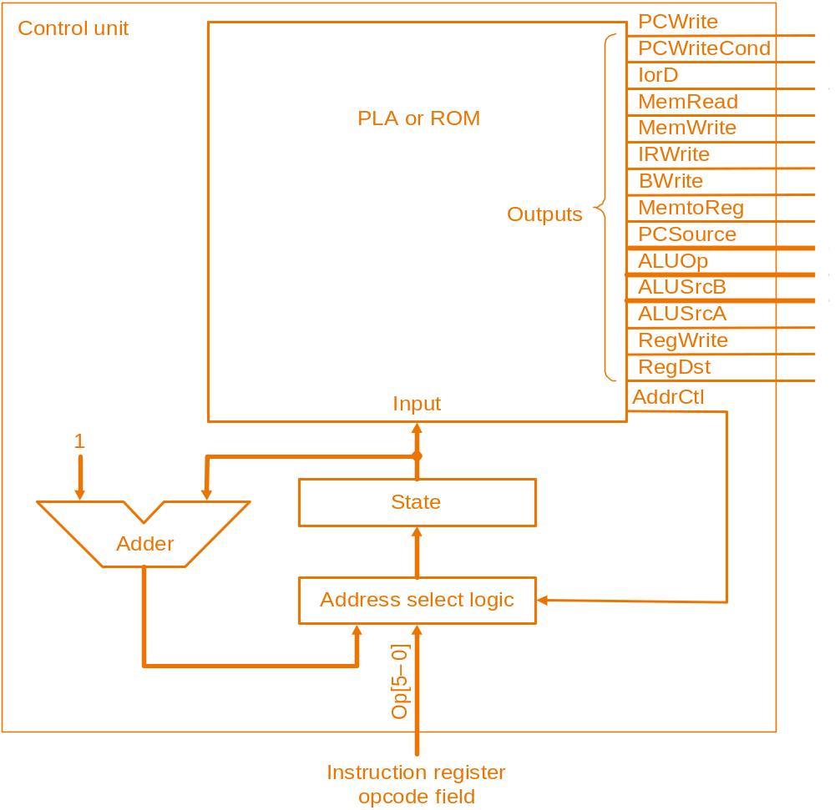
Another Implementation Style
Complex instructions: the "next state" is often current state + 1

Slide 54
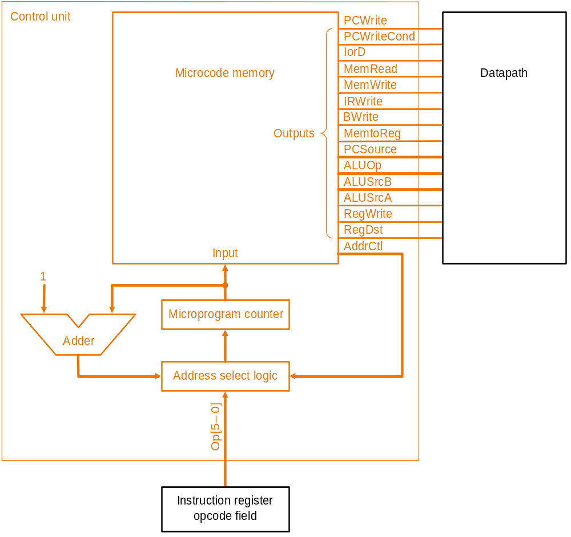
Micro- programming
What are the “microinstructions” ?

Slide 55
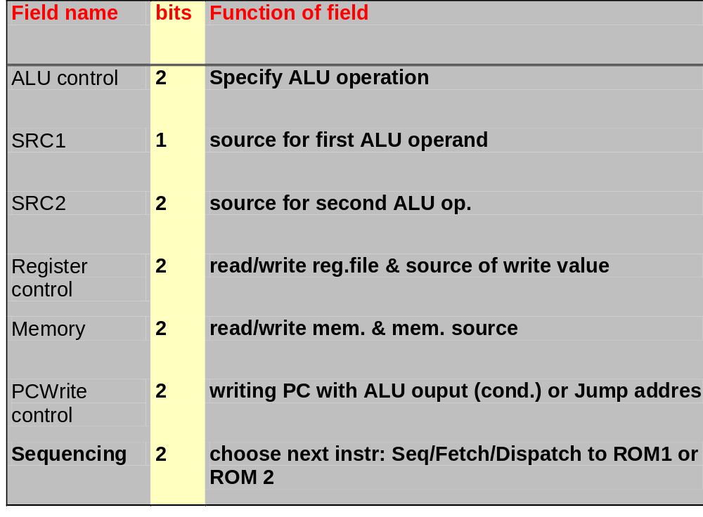
Microinstruction format
Each microinstruction contains 7 fields

Slide 56
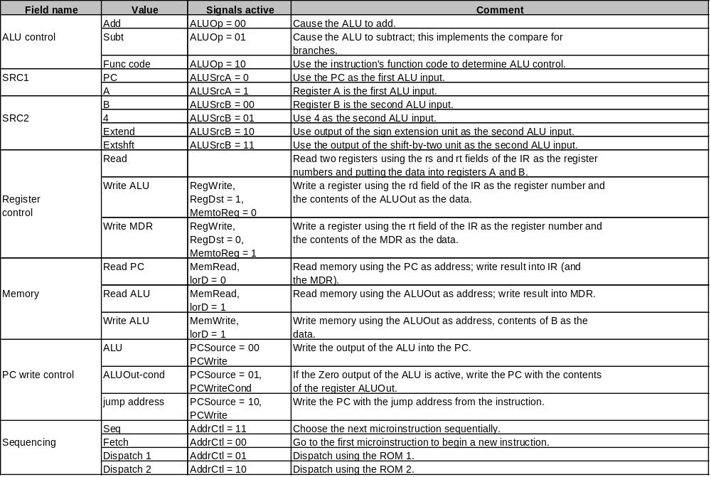
Microinstruction format

Slide 57
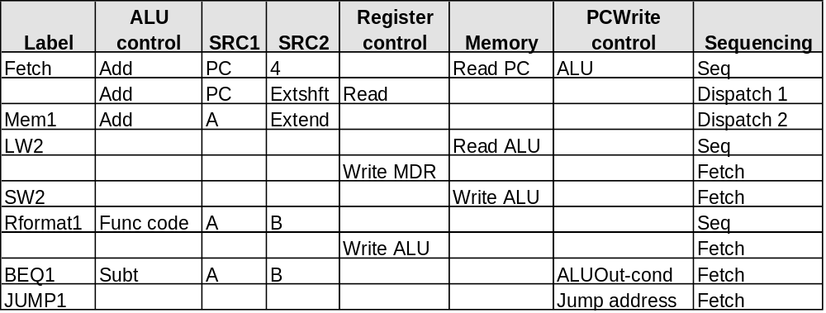
Microprogramming
A specification methodology
  appropriate if hundreds of opcodes, modes, cycles, etc.
  signals specified symbolically using microinstructions

Slide 58
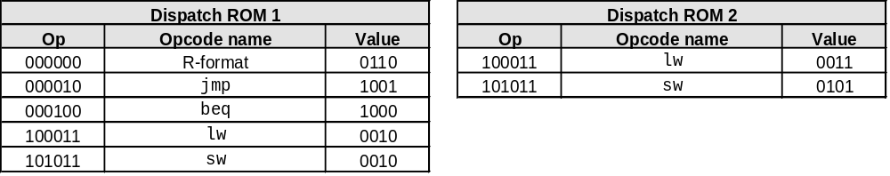
Details
P
L
A
o
r
R
O
M
1
S
t
a
t
e
A
d
d
e
r
M
u
x
A
d
d
r
C
t
l
3
2
1
0
0
D
i
s
p
a
t
c
h
R
O
M
2
D
i
s
p
a
t
c
h
R
O
M
1
A
d
d
r
e
s
s
s
e
l
e
c
t
l
o
g
i
c
p
O
I
n
s
t
r
u
c
t
i
o
n
r
e
g
i
s
t
e
r
o
p
c
o
d
e
f
i
e
l
d

Slide 59
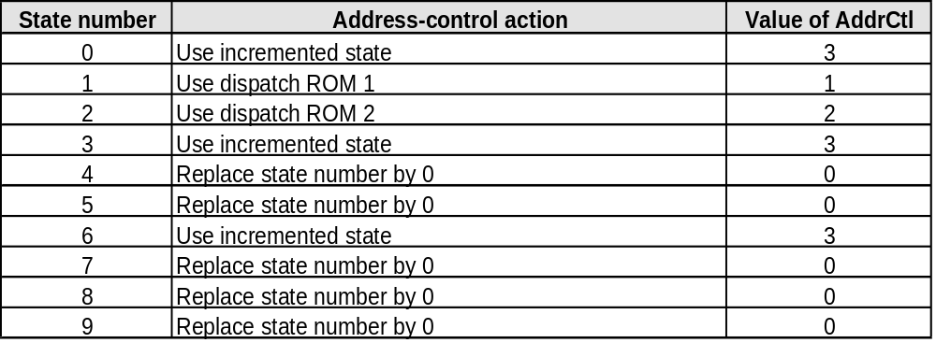
Details

Slide 60
Microprogramming
Will two implementations of the same architecture have the same microcode?
What would a microassembler do?

Slide 61
Maximally vs. Minimally Encoded
No encoding (also called horizontal encoding, or 1-hot encoding):
  1 bit for each datapath operation
  faster, requires more memory (logic)
  used for Vax 780 — an astonishing 400K of memory!
Lots of encoding (also called vertical encoding):
  send the microinstructions through logic to get control signals
  uses less memory, slower
Historical context of CISC:
  Too much logic to put on a single chip with everything else
  Use a ROM (or even RAM) to hold the microcode
  It’s easy to add new instructions

Slide 62
Microcode: Trade-offs
Distinction between specification and implementation is sometimes blurred
Specification Advantages:
  Easy to design and write
  Design architecture and microcode in parallel
Implementation (off-chip ROM) Advantages
  Easy to change since values are in memory
  Can emulate other architectures
  Can make use of internal registers
Implementation Disadvantages, SLOWER now that:
  Control is implemented on same chip as processor
  ROM is no longer faster than RAM
  No need to go back and make changes

Slide 63
Exceptions
Unexpected events
External: interrupt
  e.g. I/O request
Internal: exception
  e.g. Overflow, Undefined instruction opcode, Software trap, Page fault
How to handle exception?
  Jump to general entry point (record exception type in status register)
  Jump to vectored entry point
  Address of faulting instruction has to be recorded !

Slide 64
Exceptions
Changes needed: see fig. 5.48 / 5.49 / 5.50
Extend PC input mux with extra entry with fixed address: “C000000hex”
Add EPC register containing old PC (we’ll use the ALU to decrement PC with 4)
  extra input ALU src2 needed with fixed value 4
Cause register (one bit in our case) containing:
  0: undefined instruction
  1: ALU overflow
Add 2 states to FSM
  undefined instr. state #10
  overflow state #11

Slide 65
Exceptions
Legend:
IntCause =0/1 type of exception
CauseWrite write Cause register
ALUSrcA = 0 select PC
ALUSrcB = 01 select constant 4
ALUOp = 01 subtract operation
EPCWrite write EPC register with current PC
PCWrite write PC with exception address
PCSource =11 select exception address: C000000hex
2 New states:
#10 undefined instruction
#11 overflow
IntCause =0
CauseWrite
ALUSrcA = 0
ALUSrcB = 01
ALUOp = 01
EPCWrite
PCWrite
PCSource =11
IntCause =1
CauseWrite
ALUSrcA = 0
ALUSrcB = 01
ALUOp = 01
EPCWrite
PCWrite
PCSource =11
To state 0 (begin of next instruction)

Slide 66
Pentium Pro / II / III
Use multicycle data path for 80x86 instructions
Combine hardwired (FSM) control for simple instructions with microcoded control for complex instructions (since 80486)
Pentium Pro:
  internal RISC engine executing micro-operations (of 72 bit)
  multiple FUs
  up to four 80x86 instructions issued per cycle and translated into micro-operations (by set of PLAs generating 1200 different micro-operations)
  complex 80x86 instructions are handled by micro-code (8000 micro-instructions)
  four micro-operations issued per cycle (4x72 bits expand into 120 Int and 285 FP control lines)

Slide 67
The Big Picture
I
n
i
t
i
a
l
F
i
n
i
t
e
s
t
a
t
e
M
i
c
r
o
p
r
o
g
r
a
m
r
e
p
r
e
s
e
n
t
a
t
i
o
n
d
i
a
g
r
a
m
S
e
q
u
e
n
c
i
n
g
E
x
p
l
i
c
i
t
n
e
x
t
M
i
c
r
o
p
r
o
g
r
a
m
c
o
u
n
t
e
r
c
o
n
t
r
o
l
s
t
a
t
e
f
u
n
c
t
i
o
n
+
d
i
s
p
a
t
c
h
R
O
M
S
L
o
g
i
c
L
o
g
i
c
T
r
u
t
h
r
e
p
r
e
s
e
n
t
a
t
i
o
n
e
q
u
a
t
i
o
n
s
t
a
b
l
e
s
I
m
p
l
e
m
e
n
t
a
t
i
o
n
P
r
o
g
r
a
m
m
a
b
l
e
R
e
a
d
o
n
l
y
t
e
c
h
n
i
q
u
e
l
o
g
i
c
a
r
r
a
y
m
e
m
o
r
y

Slide 68
Exercises
From Chapter five:
5.1, 5.3
5.5, 5.6
5.9
5.12

